Slide 1


Slide 2
Team 9 Trusted News Tribune App Team Leader: Hari Sagar Velugula Team Members: Supriya Neeharika Rajesh Madhuri Kondepu

Slide 3
Storyline
Many newspapers, such as the Times, FOXfourKC, and the New York Times, describe the context of a story in great detail and length.
In today's fast-paced atmosphere, reading a complete story about an issue to a single person has become considerably more difficult.
We're building a website that, in comparison to other websites, displays daily news updates quickly. The information's quality is unaffected, and it provides an overview of the whole content.

Slide 4
Introduction
Every day, people consume vast amounts of information on the internet, with about 40% of worldwide internet users reading news online. This, of course, has an impact on their expectations of news websites. According to a joint survey conducted by the Broadcast Audience. Research Council of India (BARC) and Nielsen India, time spent on news applications and websites has increased by 41%.
Trusted News Tribune & Website is a news website and service that provides editors- selected news headlines and stories. Top stories, US, global, money, crime, technology, sports, entertainment, and opinion as well as other interesting items are all covered in the app.

Slide 5
Data
In this project, we are using the data from the different websites according to the user interest and working with that.
By using the machine learning algorithm called NLP. We are having the summarized version of the article.

Slide 6

Data & its details
In order to build our news aggregator app, we will be integrating Django with other technologies.
Scraping data from the internet with various tools and frameworks is known as “Web Scraping”. Web scraping is the process of using bots to extract content and data from a website. Web scraping is used in a variety of digital businesses that rely on data harvesting. For example, It's sometimes used to track online pricing changes, compare prices, and evaluate how well rivals are doing by scraping data from their websites.
Beautiful Soup is a Python library used for extracting data from HTML and XML files for web scraping needs. It generates a parse tree from the page source code, which may be used to extract data in a more understandable and hierarchical manner.

Slide 7
Applications
News websites are sites devoted to delivering the news in a different format than television, print or radio.
Positive news will normally cause individuals to buy stocks. Good earnings reports, an announcement of a new product, a corporate acquisition, and positive economic indicators all translate into buying pressure and an increase in stock prices.
News let people voice diverse opinions on governance and reform and help build public consensus to bring about change.

Slide 8
Team distribution
Madhuri Rajesh and Hari Sagar Supriya Niharika
Creating a news aggregator app
Web Scraping the different websites
Creating the model and view to display the page

Slide 9
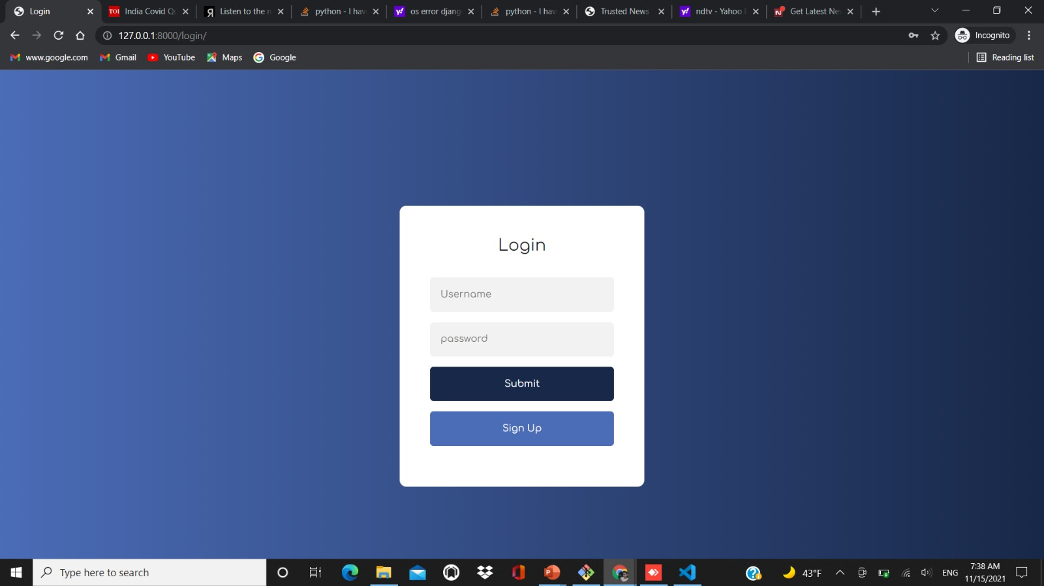
Working screens from the project:
Firstly, sign in to the website

Slide 10
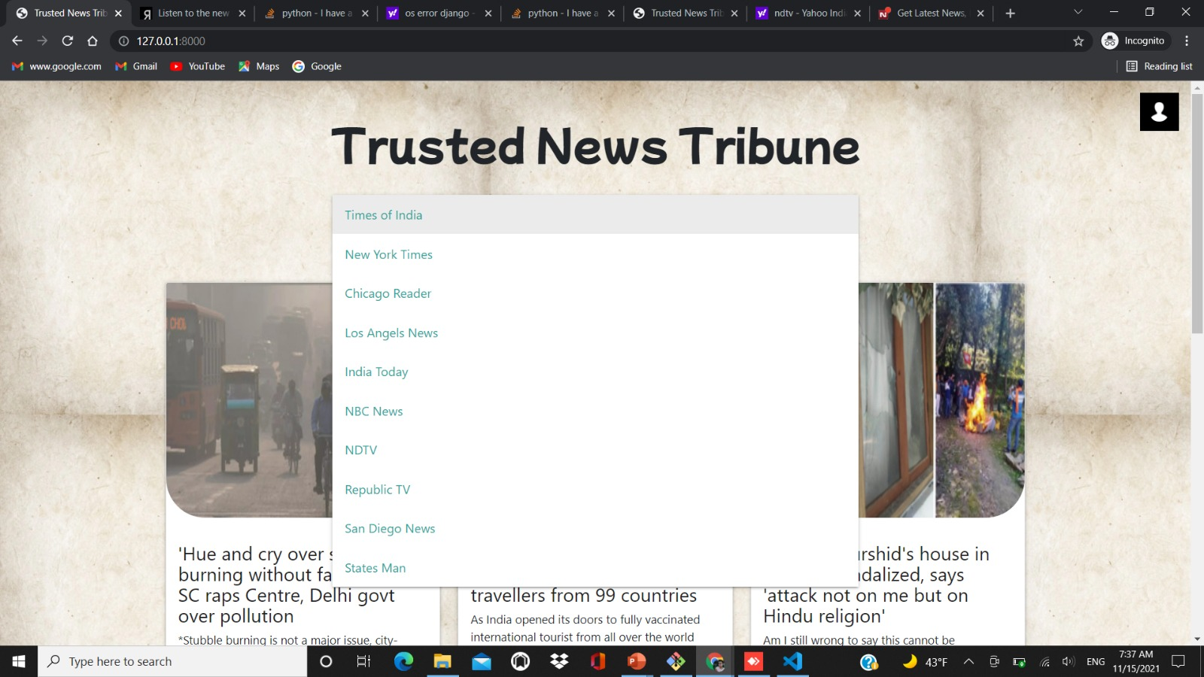
Working images from the project
User has the choice to select the website which they want to have the summarized version of the article.

Slide 11
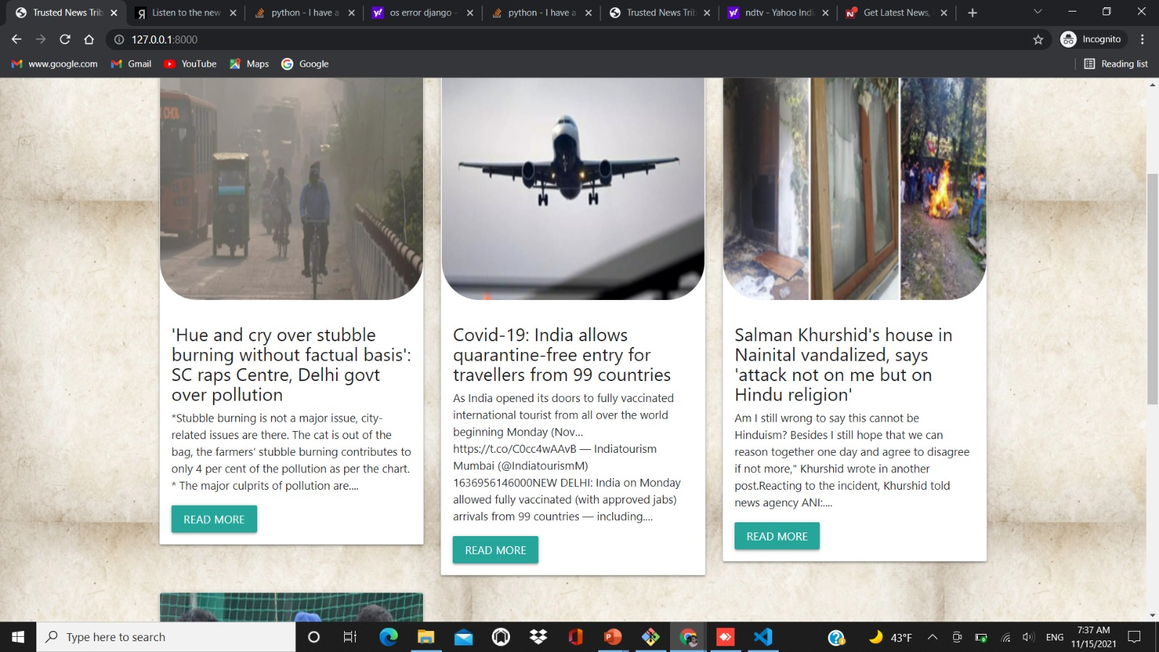
Related work images from the project
The summarized version of the data with the images.

Slide 12
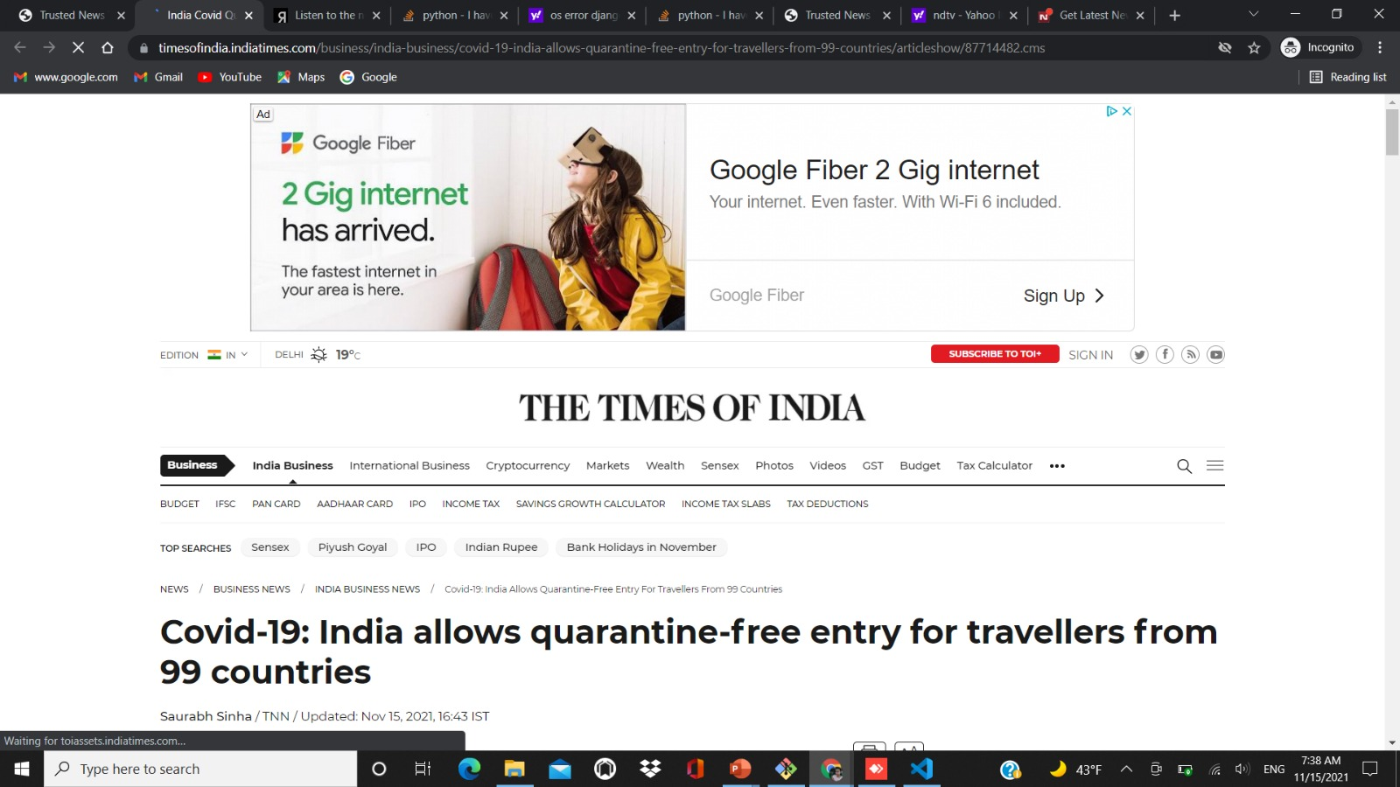
Related work images from the project
Redirecting to the website if the user wants to know more

Slide 13
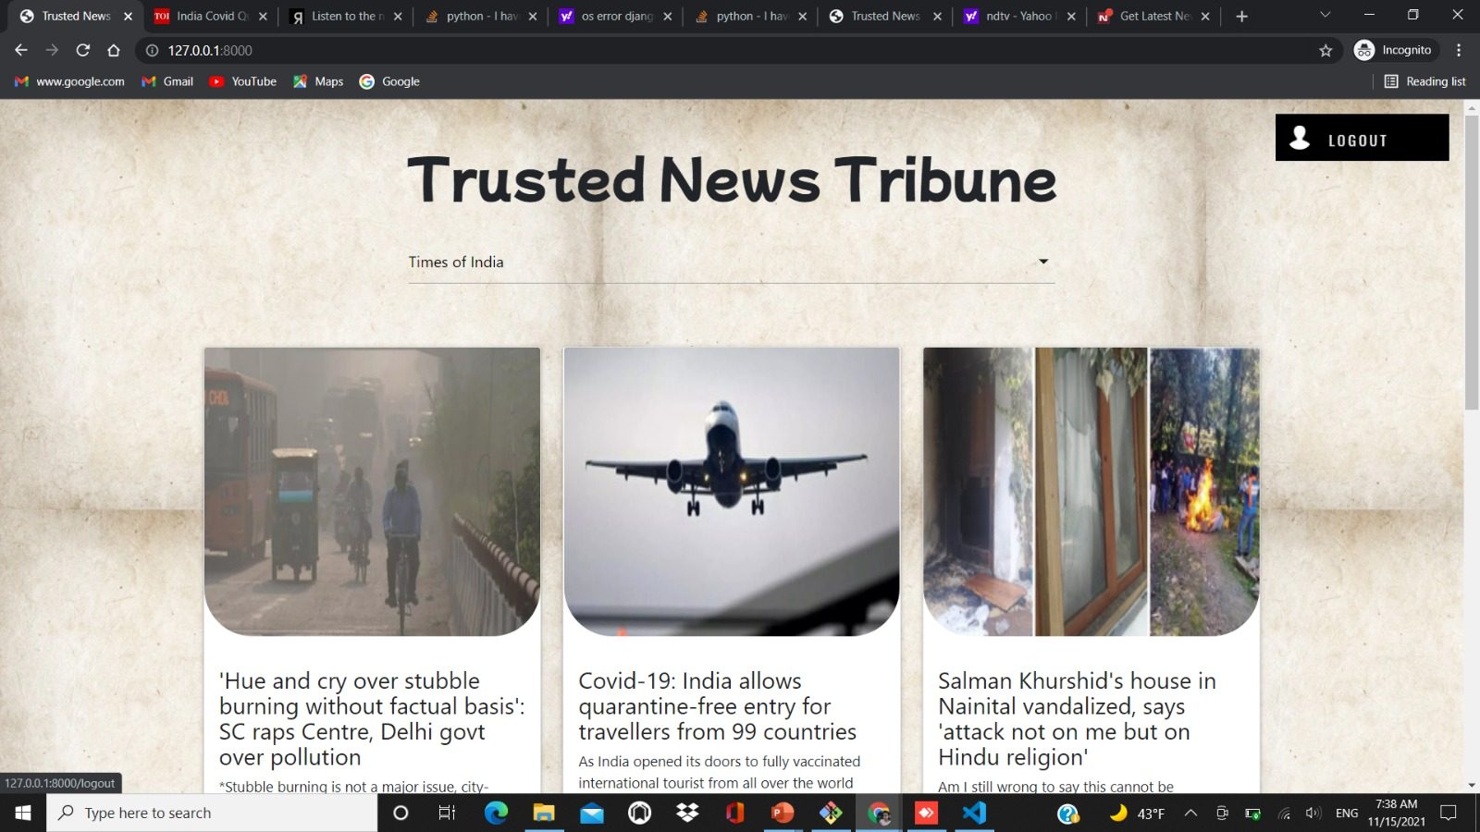
Logging out from the application.

Slide 14
References
Some of the references of our project are:
https://careerfoundry.com/en/blog/data-analytics/web-scraping-guide/
https://pypi.org/project/beautifulsoup4/
https://data-flair.training/blogs/django-project-news-aggregator-app/

Slide 15
Thank You

